Slide 1
4.1-4.4 (b) More on Objects and Classes
ITP3914 – Programming
Part 4 – Programming with Objects and Classes

Slide 2

Part 1 – Object Reference

Slide 3
Object Reference
public class Rectangle {
private double length;
private double width;
public Rectangle(double l, double w) {
length = l;
width = w;
}
public double area() {
return length * width;
}
}
We know that r1 references an object instance of class Rectangle.
But what actually is a reference?
But what actually does r1 store?
public class RectangleUser {
public static void main(String [ ] argv) {
Rectangle r1 = new Rectangle(30.1, 10.2);
Rectangle r2 = new Rectangle(25.4, 20.5);
System.out.println("r1=" + r1);
System.out.println("r2=" + r2);
System.out.println();
System.out.println("r1 area " + r1.area());
System.out.println("r2 area " + r2.area());
}
}

Slide 4
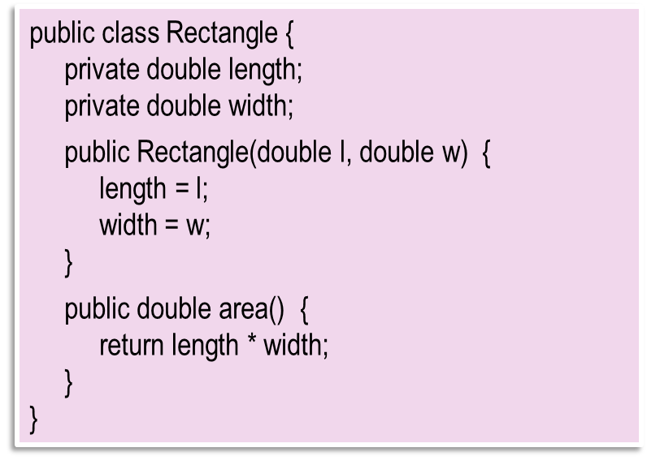
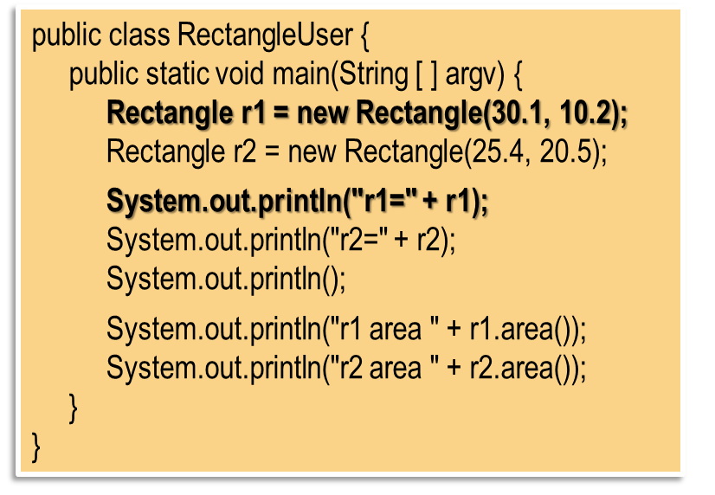

r1
19e15c
length
30.1
width
10.2
19e15c
C:\> java RectangleUser
r1=Rectangle@19e15c
r2=Rectangle@11a75a
r1 area 307.02
r2 area 520.6999999999
Rectangle r1 = new Rectangle(30.1, 10.2);
r2
11a75a
length
25.4
width
20.5
r1 and r2 are reference variables, storing the reference of an object instance. By using a reference, we are able to locate and instruct an object instance for performing its methods.
11a75a
Rectangle r2 = new Rectangle(25.4, 20.5);

Slide 5

Changing a Reference
r1
20a34d
×
32b64a
length
1.0
public class ChangeReference {
public static void main(String [ ] args) {
Rectangle r1 = new Rectangle(1.0, 2.0);
System.out.println("area = " + r1.area() );
r1 = new Rectangle(3.0, 4.0);
System.out.println("area = " + r1.area() );
}
}
width
2.0
20a34d
length
3.0
width
4.0
C:\> java ChangeReference
The same reference variable can be used to reference different object instances.
area = 2.0
32b64a
area = 12.0

Slide 6
The this reference
public class MyTime {
private int hour;
private int minute;
private int second;
public MyTime() {
setTime(0, 0, 0);
}
public MyTime(int hour, int minute, int second) {
setTime(hour, minute, second);
}
public void setTime ( int hour, int minute, int second ) {
this.hour = ( (hour >= 0 && hour < 24) ? hour : 0);
this.minute = ( (minute >= 0 && minute < 60) ? minute : 0 );
this.second = ( (second >= 0 && second < 60) ? second : 0 );
}
}
The parameter names are the same as the instance variable names.
The instance variables are hidden.
How can we access the instance variables?
Each object instance has the this reference which is a reference to the object instance itself.

Slide 7
hour
6
mt
19e15c
minute
24
second
40
this
19e15c
19e15c
MyTime mt = new MyTime(6, 24, 40);

Slide 8
Part 2 – The toString() method

Slide 9

public class DobUser {
public static void main(String [ ] args) {
Dob peter = new Dob(12, 1, 1985);
System.out.println("Peter's birthday: " + peter );
}
}
public class Dob {
private int day;
private int month;
private int year;
public Dob(int day, int month, int year) {
this.day = day;
this.month = month;
this.year = year;
}
public String toString() {
return day + "/" + month + "/" + year;
}
}
System.out.println("Peter's birthday: " + peter.toString() );
C:\> java DobUser
Peter’s birthday: 12/1/1985
Concatenating a String with an object reference results in an implicit call to the object’s toString() method.

Slide 10
Another example
import java.text.DecimalFormat;
public class MyTime {
private int hour;
private int minute;
private int second;
public MyTime() {
setTime (0, 0, 0);
}
public MyTime(int h, int m, int s) {
setTime(h, m, s);
}
public void setTime(int h, int m, int s) {
if (h>=0 && h<=23) hour = h;
if (m>=0 && m<=59) minute = m;
if (s>=0 && s<=59) second = s;
}
public String toString() {
DecimalFormat twoDigits = new DecimalFormat("00");
return ( (hour==12 || hour==0) ? 12 : hour % 12 ) + ":" + twoDigits.format(minute) +
":" + twoDigits.format(second) + ( hour < 12 ? " AM" : " PM" );
}
}
public class MyTimeUser {
public static void main(String [] args) {
MyTime mt = new MyTime(15, 26, 37);
System.out.println("The time is " + mt);
}
}
C:\> java MyTimeUser
The time is 3:26:37 PM

Slide 11
Part 3 – final variables

Slide 12
By convention, a final variable has a name composed of all UPPERCASE letters.
The final keyword specifies that the associated variable is NOT modifiable and that any attempt to modify the variable is an error.
public class FinalError {
private int count=0;
private final int INCREMENT = 5;
public int setIncrement() {
INCREMENT += 10;
}
public int getCount() {
return count;
}
}
This program statement causes a compilation error.
C:\> java ChangeReference
FinalError.java:6: error: cannot assign a value to final variable INCREMENT
INCREMENT += 10;
^
1 error

Slide 13
Example use of final variable
To change the number of students, only the final variable NUMSTUDENT needs to be changed.
The program is more robust and less pone to careless mistakes.
import java.util.*;
public class AvgScore {
public static void main(String [ ] args) {
final int NUMSTUDENT = 45;
int total = 0;
Scanner keyboard = new Scanner(System.in);
for (int i=0; i < NUMSTUDENT; i++) {
total += keyboard.nextInt();
}
System.out.println("Average score = " + total / NUMSTUDENT);
}
}

Slide 14
Initialization of final variables
public class FinalInit {
private int count=0;
private final int INCREMENT;
public FinalInit(int inc) {
INCREMENT = inc;
}
public void stepUp() {
count += INCREMENT;
}
public int getCount() {
return count;
}
}
If a final variable has not been initialized when being declared, it can be assigned with a value in the constructors (but only constructors, not other methods).

Slide 15
Part 4 – Garbage collection

Slide 16
public class FinalizeEg {
public FinalizeEg() {
System.out.println("Object created");
}
protected void finalize() {
System.out.println("method finalize() executed");
}
}
C:\> java FinalizeEgUser
Object created
method finalize() executed
public class FinalizeEgUser {
public static void main(String [] args) {
FinalizeEg obj = new FinalizeEg();
obj = null;
System.gc();
}
}
null
obj
26a28c
×
26a28c
Suggest Java to invoke the garbage collector.

Slide 17
Garbage collection
An object instance owns various resources such as memory space and opened files.
When an object instance is no longer used in the program (i.e. there are no references to the object), the object is marked as a garbage.
Java performs automatic garbage collection.
Java checks if there is any garbage objects from time to time, and automatically destroys the garbage objects and reclaims the resources.

Slide 18
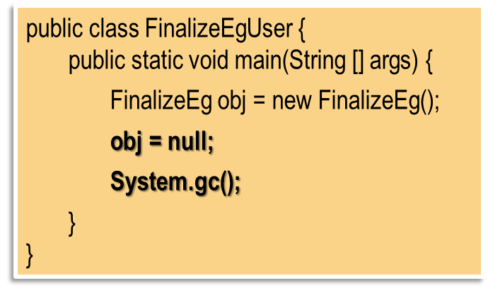

In the example, the statement
obj = null;
sets the reference variable obj to null, thus obj no more references the object instance.
Since obj was the only variable referencing the object instance, no more variable references the object instance any more.
The object instance thus became a garbage.
The statement System.gc(); suggests to Java that garbage collection be executed.

Slide 19
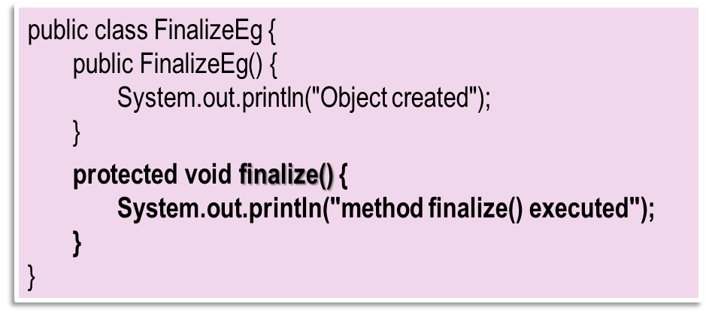
A finalizer is a method that performs any cleanup operation before an object instance is garbage collected.
The finalizer method is called by the Java garbage collector automatically and implicitly.
The finalizer method is declared as:
protected void finalize() {
…
}

Slide 20
Another Example
public class FinalTestUser {
public static void main(String [] args) {
System.out.println("Class Count = " +
FinalTest.getCount());
System.out.println();
FinalTest ft1 = new FinalTest();
System.out.println("ft1 Count = " + ft1.getCount());
System.out.println();
FinalTest ft2 = new FinalTest();
System.out.println("ft2 Count = " + ft2.getCount());
System.out.println("-----------------------");
ft1 = null;
ft2 = null;
System.gc();
System.out.println("-----------------------");
System.out.println("Class Count = " +
FinalTest.getCount());
}
}
public class FinalTest {
private static int count=0;
public FinalTest() {
count++;
System.out.println("FinalTest object created");
}
public static int getCount() {
return count;
}
protected void finalize() {
System.out.println("Destroying object:");
count--;
System.out.println("Count becomes " + count);
System.out.println("FinalTest object destroyed\n");
}
}
C:\> java FinalTestUser
Class Count = 0
FinalTest object created
ft1 Count = 1
FinalTest object created
ft2 Count = 2
-----------------------
-----------------------
Destroying object:
Count becomes 1
FinalTest object destroyed
Class Count = 1
Destroying object:
Count becomes 0
FinalTest object destroyed
Can you explain why this line of output goes to here?

Slide 21
Part 5 – Objects and methods again

Slide 22
Example 1
public class Circle {
private int x, y;
private double radius;
public Circle(int x, int y, double radius) {
this.x = x;
this.y = y;
this.radius = radius;
}
public int getX() { return x; }
public int getY() { return y; }
public double getRadius() { return radius; }
public boolean isOverlap(Circle c) {
double distance = Math.sqrt(
(x-c.getX())*(x-c.getX()) +
(y-c.getY())*(y-c.getY()));
if (distance < (radius+c.getRadius()))
return true;
else
return false;
}
}
This example illustrates the mechanism of passing an object reference to a method.
public class CircleTest {
public static void main(String [ ] args) {
Circle c1 = new Circle(1, 1, 2.5);
Circle c2 = new Circle(3, 4, 3.5);
System.out.println( c1.isOverlap(c2) );
}
}
C:\> java CircleTest
true

Slide 23
public class CircleTest {
public static void main(String [ ] args) {
Circle c1 = new Circle(1, 1, 2.5);
Circle c2 = new Circle(3, 4, 3.5);
System.out.println( c1.isOverlap( c2 ) );
}
}
23

Slide 24
public class CircleTest {
public static void main(String [ ] args) {
Circle c1 = new Circle(1, 1, 2.5);
Circle c2 = new Circle(3, 4, 3.5);
System.out.println( c1.isOverlap( c2 ) );
}
}
c1
19e15c
x
3
c2
11a75a
y
4
radius
3.5
11a75a
11a75a
x
1
public boolean isOverlap(Circle c) {
double distance = Math.sqrt(
(x-c.getX())*(x-c.getX()) +
(y-c.getY())*(y-c.getY()));
if (distance < (radius+c.getRadius()))
return true;
else
return false;
}
c
11a75a
y
1
radius
2.5
19e15c
24

Slide 25
Example 2
public class Fraction {
private int num, den;
public Fraction(int num, int den) {
this.num = num;
this.den = den;
}
private int findGcd(int a, int b) {
if (b==0)
return a;
else if (b>a)
return findGcd(b, a);
else
return findGcd(b, a%b);
}
public String toString() { return num + "/" + den; }
public Fraction multiply(int n) {
int num = this.num * n;
int den = this.den;
int gcd = findGcd(num, den);
num = num / gcd;
den = den / gcd;
Fraction f = new Fraction(num, den);
return f;
}
}
This example illustrates the mechanism of returning an object from a method.
public class FractionUser {
public static void main(String [] args) {
Fraction f1 = new Fraction(3, 4);
Fraction f2 = f1.multiply(10);
System.out.println(f1 + " * 10 = " + f2);
}
}
C:\> java FractionUser
3/4 * 10 = 15/2

Slide 26
public class FractionUser {
public static void main(String [ ] args) {
Fraction f1 = new Fraction(3, 4);
Fraction f2 = f1.multiply(10);
System.out.println(f1 + " * 10 = " + f2);
}
}
f1
24b36a
f2
12e36e
num
15
den
2
12e36e
public Fraction multiply(int n) {
int num = this.num * n;
int den = this.den;
int gcd = findGcd(num, den);
num = num / gcd;
den = den / gcd;
Fraction f = new Fraction(num, den);
return f;
}
num
3
f
12e36e
den
4
24b36a
26

Slide 27

END.

